Slide 1
SOFTWARE DESIGN AND ARCHITECTURE
Theory lecture+PRACTICAL#08
STRUCTURAL DESIGN PATTERNS
(ADAPTER PATTERN)

Slide 2
STRUCTURAL DESIGN PATTERNS
A structural design pattern serves as a blueprint for how different classes and objects are combined to form larger structures.
Unlike creational patterns, which are mostly different ways to fulfill the same fundamental purpose, each structural pattern has a different purpose. What unifies structural patterns? They all involve connections between objects.
Structural patterns define how each component or entity should be structured so as to have very flexible interconnecting modules which can work together in a larger system.

Slide 3
ADAPTER
Intent: Convert the interface of a class into another interface clients expect. Adapter lets classes work together that couldn't otherwise because of incompatible interfaces.
Also Known As: Wrapper

Slide 4
Problem
An "off the shelf" component offers compelling functionality that you would like to reuse, but its "view of the world" is not compatible with the philosophy and architecture of the system currently being developed.

Slide 5
Motivation
The adapter pattern is adapting between classes and objects. Like any adapter in the real world it is used to be an interface, a bridge between two objects. In real world we have adapters for power supplies, adapters for camera memory cards, and so on. Probably everyone have seen some adapters for memory cards.
What about software development? It's the same. Can you imagine a situation when you have some class expecting some type of object and you have an object offering the same features, but exposing a different interface? Of course, you want to use both of them so you don't to implement again one of them, and you don't want to change existing classes, so why not create an adapter...

Slide 6
Applicability
Use the Adapter pattern when
you want to use an existing class, and its interface does not match the one you need.
you want to create a reusable class that cooperates with unrelated or unforeseen classes, that is, classes that don't necessarily have compatible interfaces.
(object adapter only) you need to use several existing subclasses, but it's impractical to adapt their interface by subclassing every one. An object adapter can adapt the interface of its parent class.

Slide 7
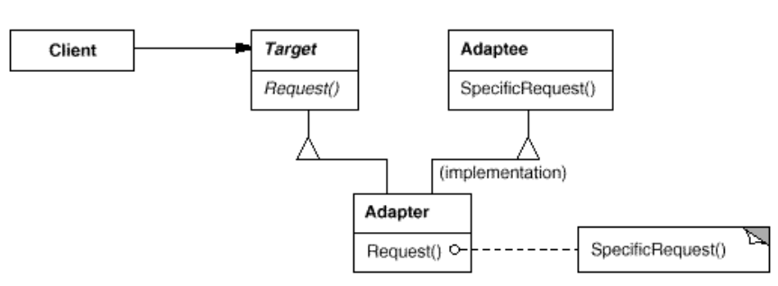
Structure

Slide 8
Participants
Target
defines the domain-specific interface that Client uses.
Client
collaborates with objects conforming to the Target interface.
Adaptee
defines an existing interface that needs adapting.
Adapter
adapts the interface of Adaptee to the Target interface.

Slide 9
Collaborations
Clients call operations on an Adapter instance. In turn, the adapter calls Adaptee operations that carry out the request.

Slide 10
Software Examples of Adapter Patterns:
Wrappers used to adopt 3rd parties libraries and frameworks - most of the applications using third party libraries use adapters as a middle layer between the application and the 3rd party library to decouple the application from the library. If another library has to be used only an adapter for the new library is required without having to change the application code.

Slide 11
Implementation
The Two-Ways Adapters are adapters that implements both interfaces of Target and Adaptee. The adapted object can be used as Target in new systems dealing with Target classes or as Adaptee in other systems dealing with Adaptee classes.
Adapter can call the method of the existing class (since the Adapter inherits from the existing class) and can work in the existing library (since the Adapter implements the interface of the existing library).

Slide 12
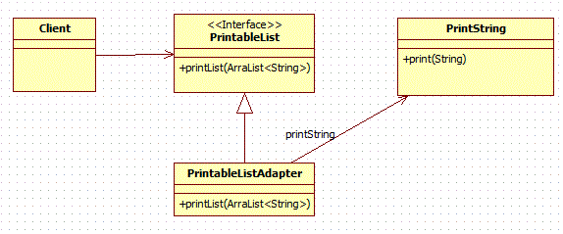
Example (UML Diagram)
Notes:
Class Adapter

Slide 13
This example includes following elements: PrintableList(Target)
PrintString(Adaptee)
PrintableListAdapter(Adapter)

Slide 14
Java code
This is the Adaptee.
public class PrintString {
public void print(String s)
{ System.out.println(s);
}
}

Slide 15
Client deals with ArrayList<String> but not with string. We have provided a PrintableList interface that expects the client input. This is our target.
import java.util.ArrayList;
public interface PrintableList {
void printList(ArrayList<String> list);
}

Slide 16
This is our adapter.
import java.util.ArrayList;
public class PrintableListAdapter implements PrintableList{
public void printList(ArrayList<String> list) {
//Converting ArrayList<String> to String so that we can pass String to adaptee class
String listString = "";
for (String s : list)
{ listString += s + "\t"; }
// instantiating adaptee class
PrintString ps=new PrintString();
ps.print(listString);
}
}

Slide 17
Client class
import java.util.ArrayList;
public class AdapterDesignPatternMain {
public static void main(String[] args) {
ArrayList<String> list=new ArrayList<String>();
list.add("one");
list.add("two");
list.add("three");
PrintableList pl=new PrintableListAdapter();
pl.printList(list);
}
}

Slide 18
Practical # 08
Objective: To implement adapter design pattern.
Task: Implement Adapter Design Pattern in any suitable scenario.

